Slide 1

Online Test Management System
Team Members :
Sowmya Griddhaluru
Swapnil Lakhe
Ujjwal Raj
Subhash Ponugoti
Yugandhar Raju B S
Team Members:
Capgemini India Technology Services
Plot 72 & 73, EPIP Zone, Vijayanagar, KIADB Export Promotion Industrial Area, Whitefield, Bengaluru, Karnataka 560066

Slide 2
Table of Contents
1.Introduction
2. Overview
3. Epic & Stories
4. Use Classes
4.1)User
4.1. a) Add Test
4.1.b) Update Test
4.1.c) Delete Test
4.2)Test
4.2.a) Assign Test
4.3) Questions
4.3.a) Add Question
4.3.b) Update Question
4.3.c) Delete Question
5. Case Diagram
6. Class Diagram
7. Sequence Diagram
8. Conclusion

Slide 3
Introduction:-
Online Examination System is a technology-driven way to simplify examination activities like defining exam patterns with question banks, defining exam timer, objective/ subjective question sections, conducting exams using the computer or mobile devices in a paperless manner.
Online Examination System is a cost-effective, scalable way to convert traditional pen and paper-based exams to online and paperless mode.
Candidates can appear for the exam using any desktop, laptop, or mobile device with a browser. Exam results can be generated instantly for the objective type of questions.
It can simplify overall examination management and result in generation activity.

Slide 4
Overview :-
User can be admin,employee,Student,etc.
A user can give only onetest at a time and see questions whereas the admin can add and update test and also add questions to a specific test.
The admin can also delete tests and the questions in them and assign the tests to a specific user.
A single user giving or being assigned to multiple tests at any given pointof time.
TECHNOLOGIES USED
Front end as:- Swagger UI
Back end as:- Java
Server:- Apache tomcat 9.0/Spring Boot
Querying language:- Sql

Slide 5
Epic & Stories
Epic | Stories | As a/an | I want to | So that
Authentication System | Login | User | Enter my correct credentials and login | I will successfully login to the system
 |  | User | Enter my incorrect credentials and login | I will not be able to successfully login to the system
 | Forgot Password | User | Change my password if I have forgotten my password | I can successfully change my password to a new one
 | Logout | User | Come out of my system | I will be successfully be able to logout of the system

Slide 6
Epic | Stories | As a/an | I want to | So that ..
Online Test Management System | Add a test | Admin | Add a test to the platform. | A new test is added for the user/admin.
 | Update test | Admin | Update a test in the platform. | To change some fields in the test.
 | Delete a test | Admin | To delete a test. | Test/questions will be deleted from test platform.
 | Assign test | Admin | To assign a perticular test to user. | A test will be assigned to the user.
 | Add questions | Admin | To add new questions to test. | New questions will be added to the test.
 | Update Questions | Admin | Update specific questions in the test. | Questions in the test will be updaed.
 | Delete Questions | Admin | To delete questions from the test. | Specific questions will be deleted from the test.

Slide 7
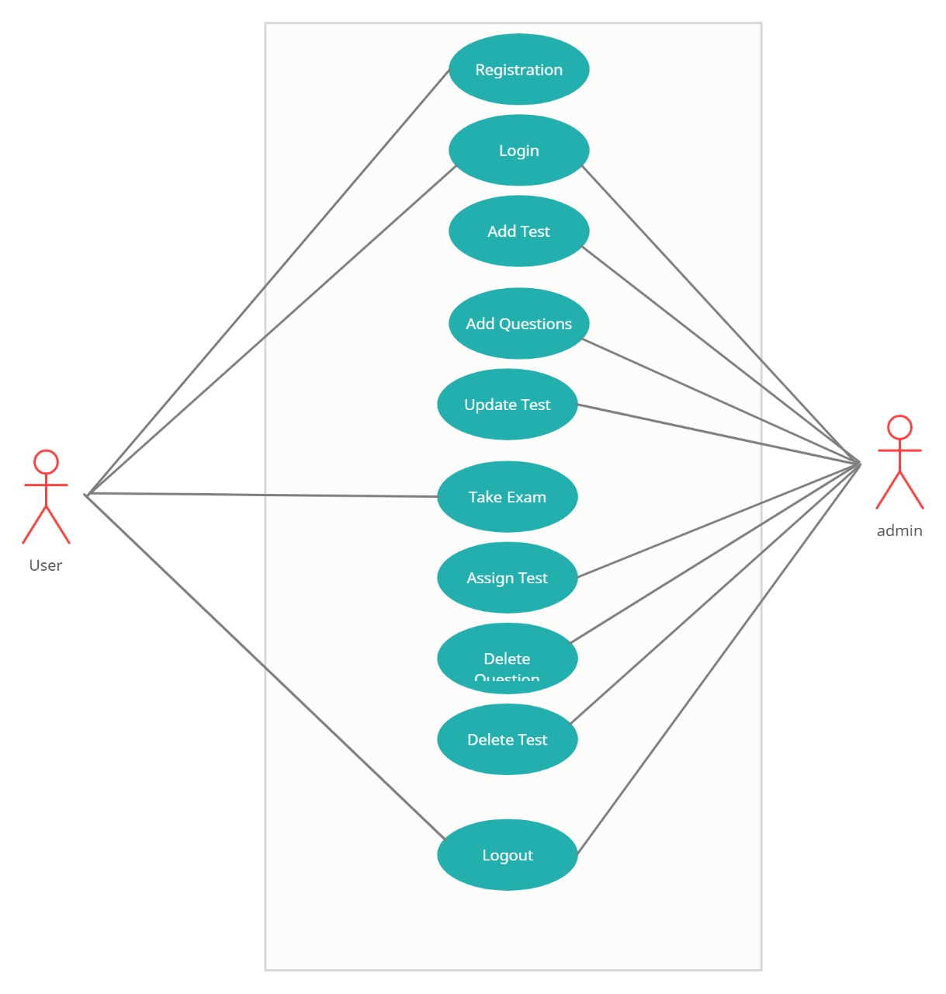
Case Diagram For User And Admin :-

Slide 8
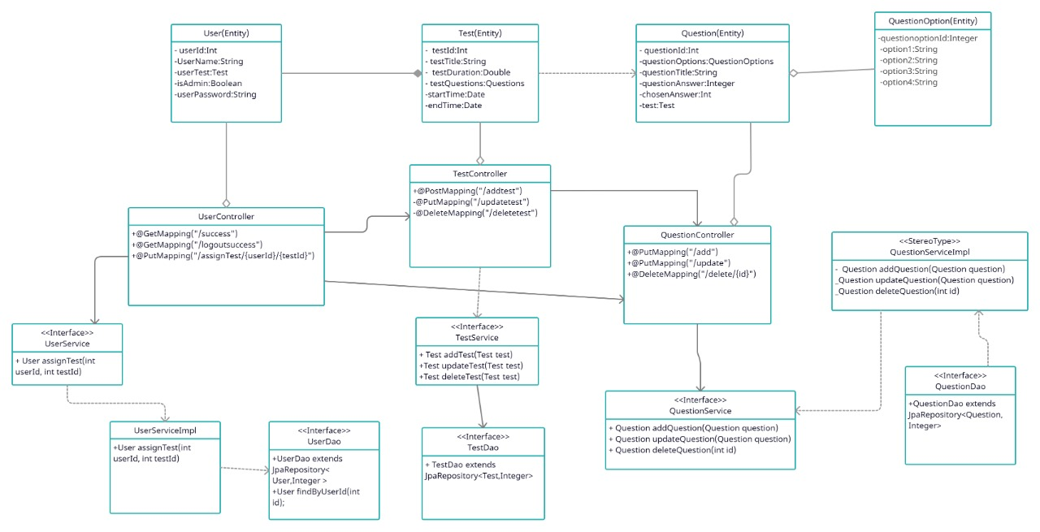
Class Diagram:-

Slide 9
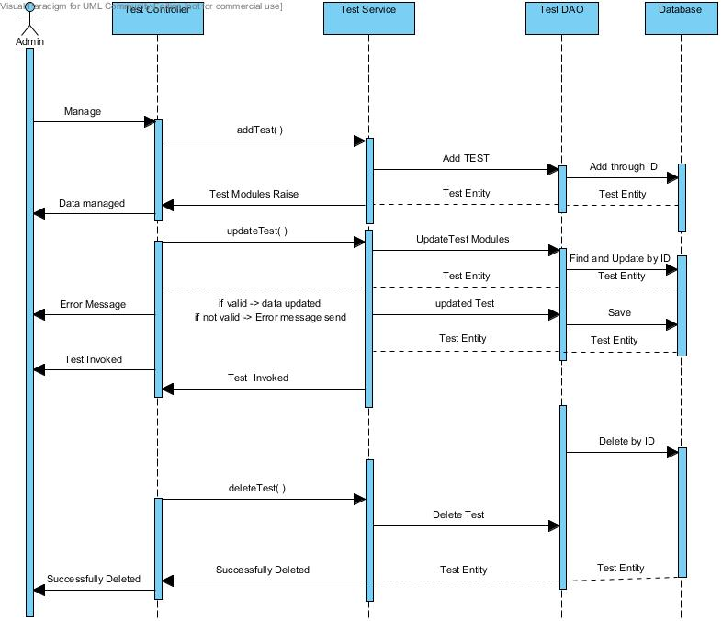
Sequence Diagram For Admin :-

Slide 10
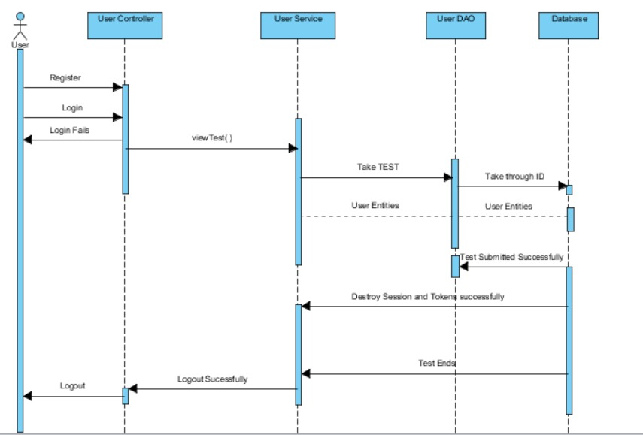
Sequence Diagram for User :-

Slide 11
Conclusion:-
With the completion of this project I conclude that it has achieved its purpose. The whole project provides a base for students to take their exam using software and allow lecturers to add questions and answers into the system. The system is developed using Java programming language and data are saved in the database.
Online examination system for introduction to management course is the best compared to paper-based exam. The automated system helps students and lecturers to save time and makes the process faster. It saves space since answers papers will not be used. With a user friendly system that has security, integrity and the database is neither inconsistent nor redundant.

